Slide 1
Resistance
of a Conductor
Senior High Physics · Electric Circuits
RESISTANCE OF A CONDUCTOR
1

Slide 2
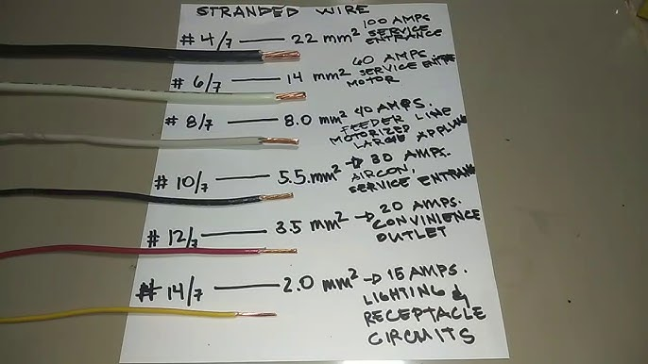
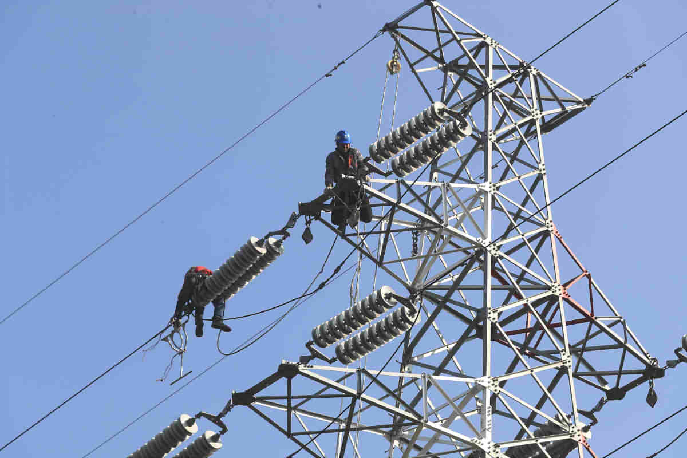
OPENING QUESTION
Why are these wires so different?
Household wiring: every gauge carries a different maximum current
High-voltage lines: thick, bare aluminium — why?
Same metal, same electricity — yet thickness, length and material all matter. By the end of this lesson you will be able to say exactly how much they matter.
RESISTANCE OF A CONDUCTOR
2

Slide 3
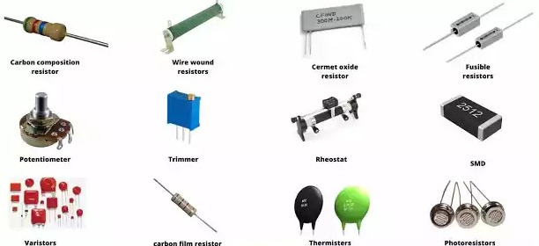
CONTEXT
Sometimes resistance is the whole point
Every conductor resists
Wires, filaments, even your body — anything that carries current opposes it to some degree.
Resistors are deliberate
Manufactured components that provide a precise, reliable amount of resistance.
Why we need them
They set currents and divide voltages — the quiet workhorses of every circuit.
Fixed, variable, thermal, light-dependent — a family portrait of resistors
RESISTANCE OF A CONDUCTOR
3

Slide 4
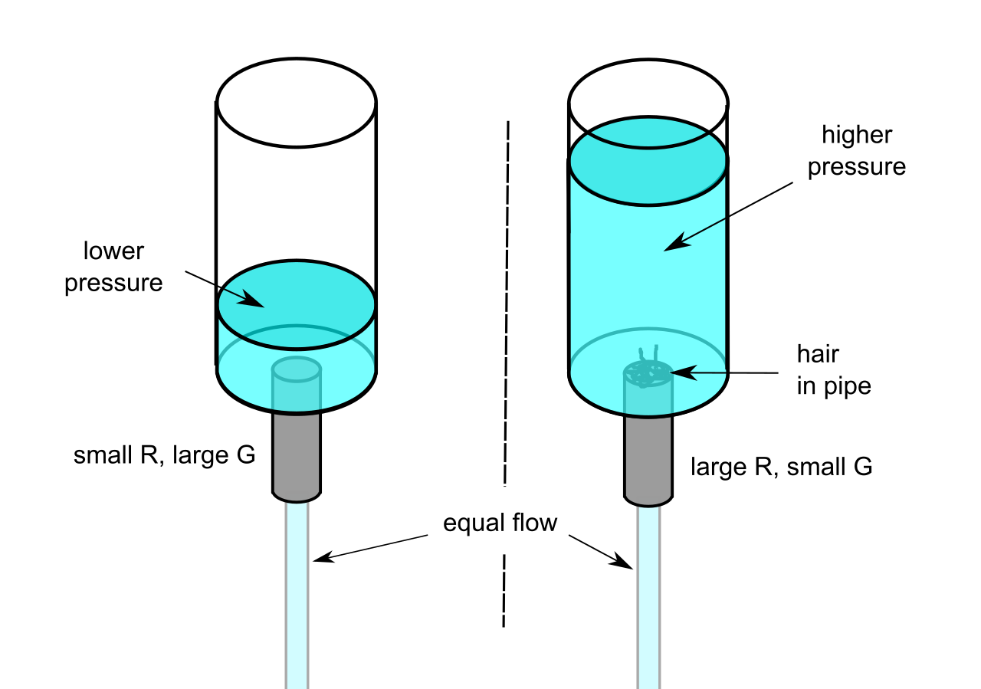
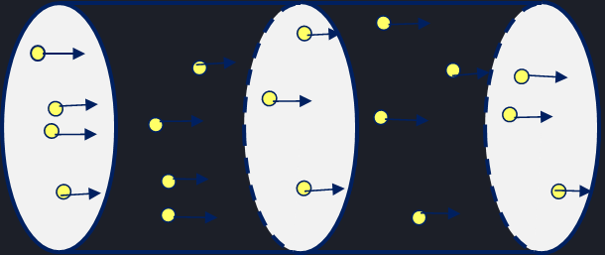
THE MICROSCOPIC PICTURE
Where does resistance come from?
Inside a metal, free electrons drift through a lattice of vibrating positive ions.
Each collision with an ion disturbs the drift — the accumulated effect is what we call resistance.
Water analogy: an obstructed pipe needs more pressure for the same flow
Drifting electrons scatter off lattice ions
RESISTANCE OF A CONDUCTOR
4

Slide 5
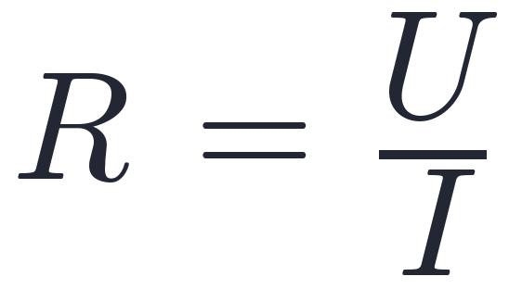
DEFINITION
Putting a number on it
A ratio at one operating point
R compares the voltage across a conductor with the current through it — measured together, at the same moment.
A property of the conductor
R is set by the conductor itself — its material, its dimensions, its temperature — not by the circuit you put it in.
unit: ohm — 1 Ω = 1 V/A
Universal
R = U/I defines resistance for every element — linear or not. No assumptions required.
RESISTANCE OF A CONDUCTOR
5

Slide 6
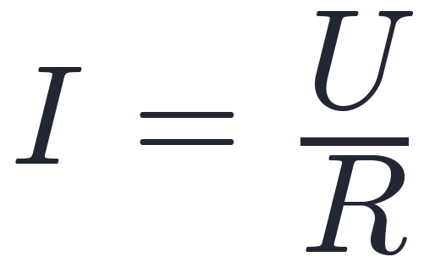
LAW
Ohm's law — and its limits
✓ WHERE IT HOLDS
✗ WHERE IT FAILS
Metallic conductors
Electrolyte solutions
Gas discharge tubes
Semiconductor devices
Motors, electrolytic cells
current is proportional to voltage — for some conductors, at steady temperature
Keep the two ideas apart: R = U/I defines resistance — always. Ohm's law claims I grows in proportion to U — a special property of some materials, not a definition.
RESISTANCE OF A CONDUCTOR
6

Slide 7
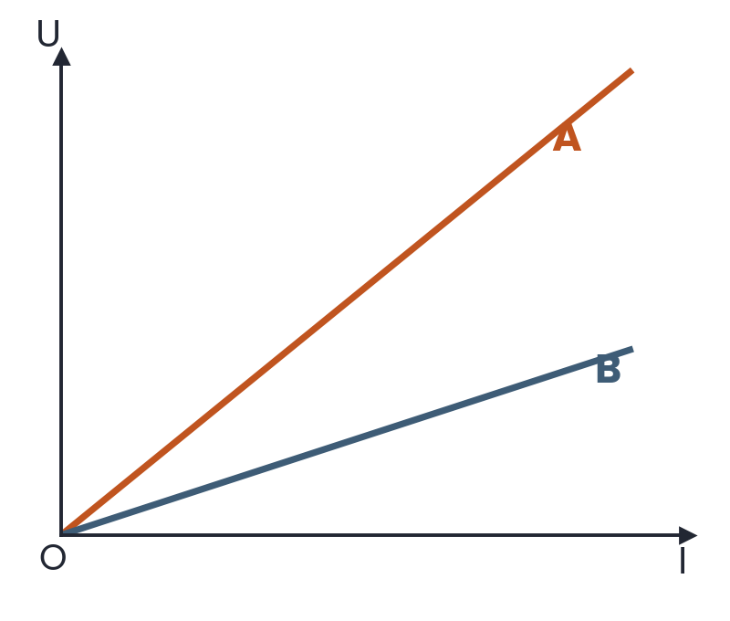
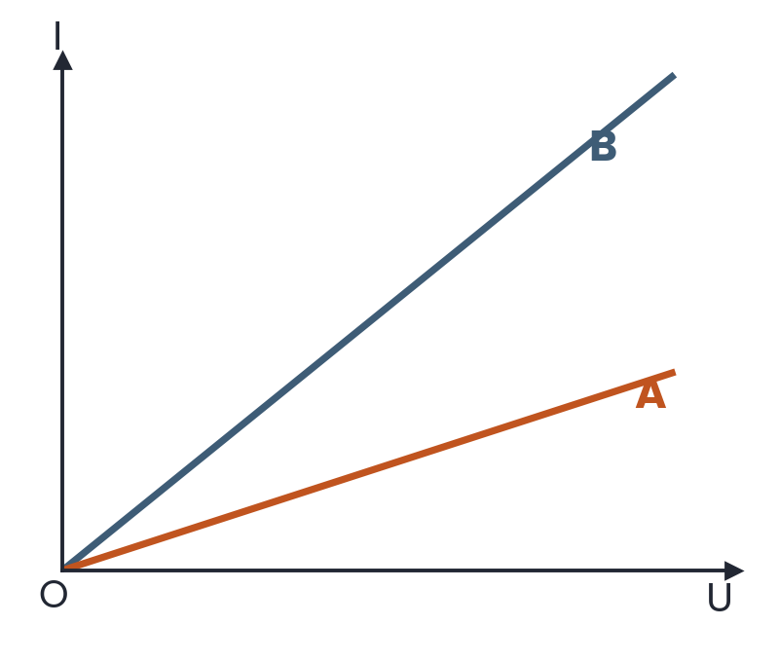
I–U CHARACTERISTICS
Reading resistance from a graph
U–I graph: slope = R. The steeper line (A) has the larger resistance.
I–U graph: slope = 1/R. The steeper line (B) has the smaller resistance.
The same two conductors — opposite-looking pictures. Check the axes before you compare slopes.
RESISTANCE OF A CONDUCTOR
7

Slide 8
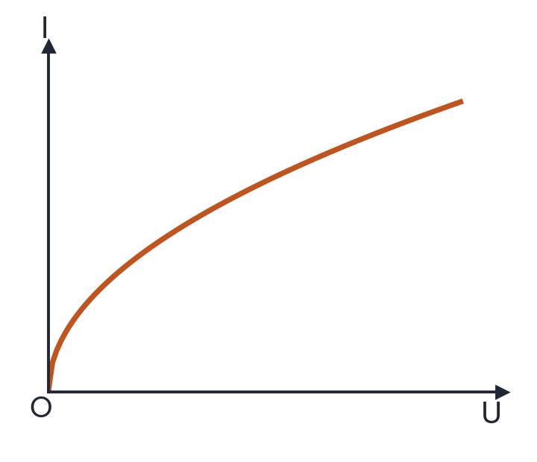
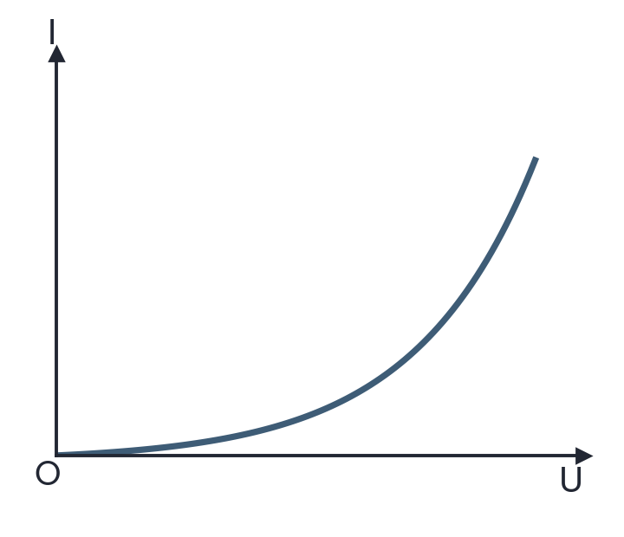
BEYOND THE STRAIGHT LINE
Non-ohmic elements
Filament lamp. Current heats the filament; R rises, the curve bends toward the U axis.
Semiconductor diode. Resistance collapses as U rises; the curve bends toward the I axis.
R = U/I still gives the resistance at every point of these curves — what is lost is only the proportionality.
RESISTANCE OF A CONDUCTOR
8

Slide 9
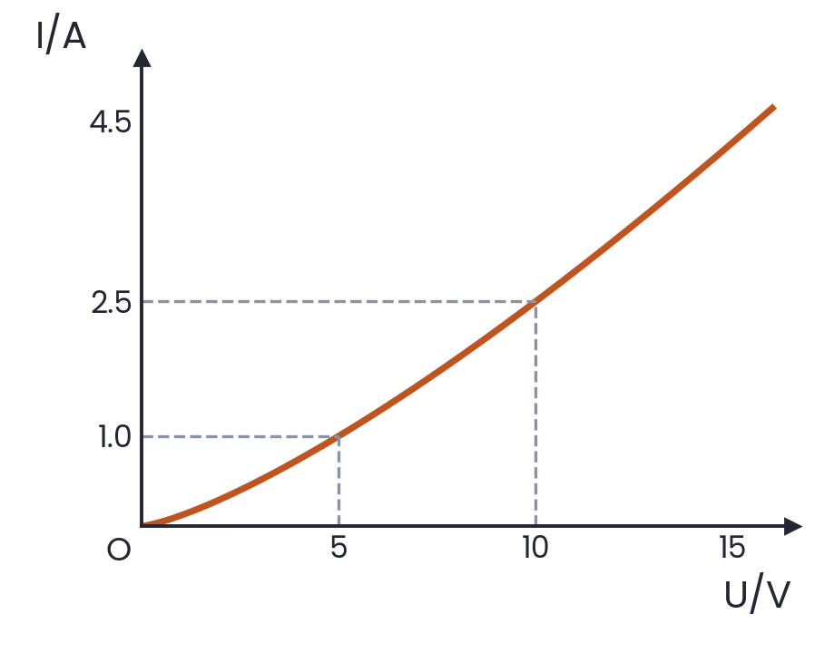
QUICK CHECK
The graph shows I against U for a conductor
Which statements are correct? Choose all that apply.
A
The element is non-linear, so R = U/I cannot be used to find its resistance
✓
B
At U = 5 V its resistance is about 5 Ω
C
Its resistance increases as the voltage rises
✓
D
Its resistance decreases as the voltage rises
ANSWER B · D Read R = U/I at each point: 5 V / 1.0 A = 5 Ω, but 10 V / 2.5 A = 4 Ω — the ratio is falling. The definition works fine on a curve; only Ohm's law is off-limits.
RESISTANCE OF A CONDUCTOR
9

Slide 10
EXPERIMENT
What determines the resistance of a wire?
01
02
03
04
Length
Cross-section
Material
Temperature
Four suspects — so we change one at a time and hold the rest fixed: the control-variables method.
RESISTANCE OF A CONDUCTOR
10

Slide 11
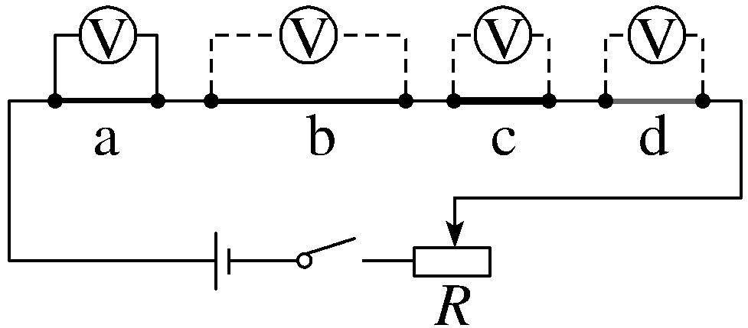
EXPERIMENT · DESIGN
One circuit, three fair comparisons
a vs b
only the length differs
a vs c
only the cross-section differs
a vs d
only the material differs
Conductors a–d in series — a voltmeter across each
In series the current is the same everywhere, so U = IR makes each voltmeter reading directly proportional to that conductor's resistance.
RESISTANCE OF A CONDUCTOR
11

Slide 12
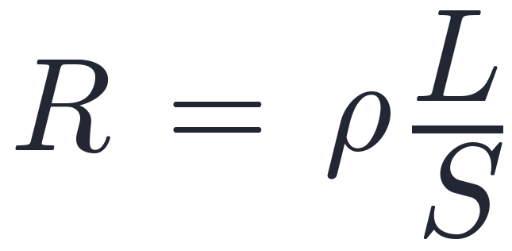
EXPERIMENT · RESULT
The resistance law
RESISTIVITY AT 20 °C
Silver
1.6 × 10⁻⁸ Ω·m
Copper
1.7 × 10⁻⁸ Ω·m
Aluminium
2.9 × 10⁻⁸ Ω·m
Tungsten
5.3 × 10⁻⁸ Ω·m
ρ resistivity (Ω·m) — set by the material
L length S cross-sectional area
Nichrome (alloy)
≈ 110 × 10⁻⁸ Ω·m
Double the length — double the resistance. Double the cross-section — halve it. The alloy stands a hundred times higher: that is why heating elements are nichrome, not copper.
RESISTANCE OF A CONDUCTOR
12

Slide 13
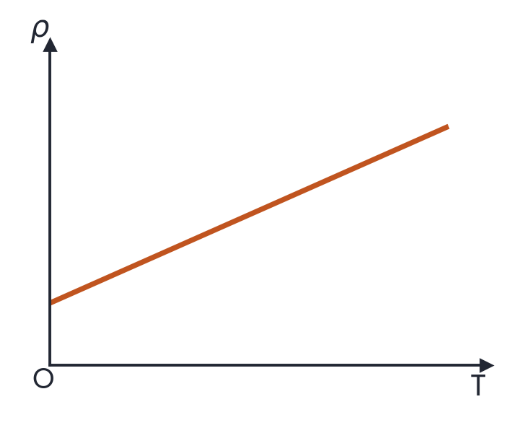
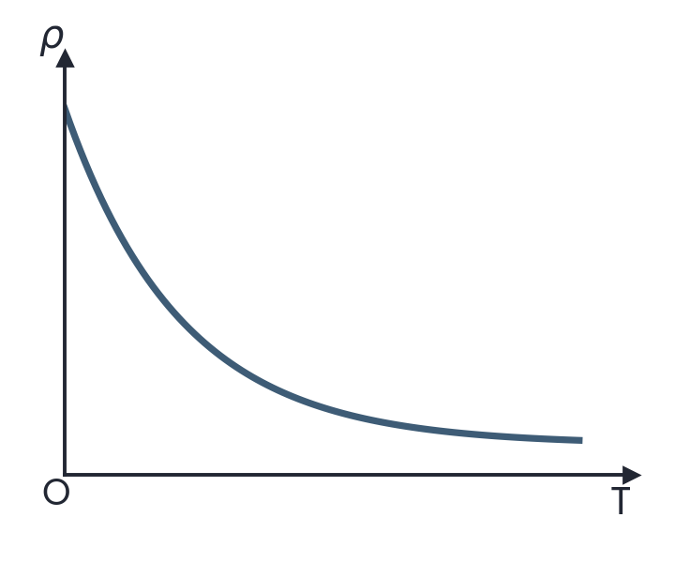
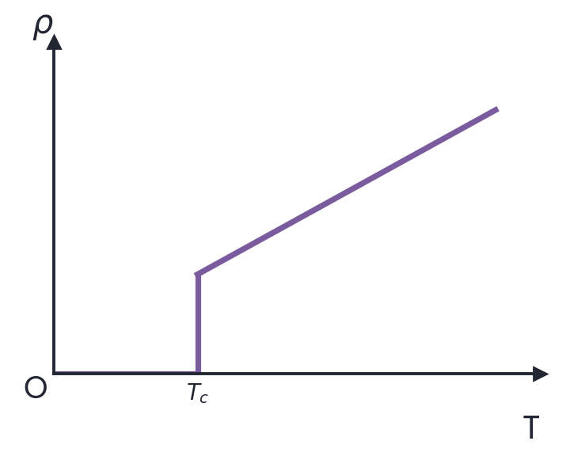
GOING FURTHER
Resistivity moves with temperature
Metals
Semiconductors
Superconductors
ρ rises steadily with T — the basis of resistance thermometers
ρ falls sharply as T rises — thermistors exploit this
below a critical temperature, resistivity vanishes entirely
Alloys such as manganin barely move with temperature — exactly what you want in a standard resistor.
RESISTANCE OF A CONDUCTOR
13

Slide 14
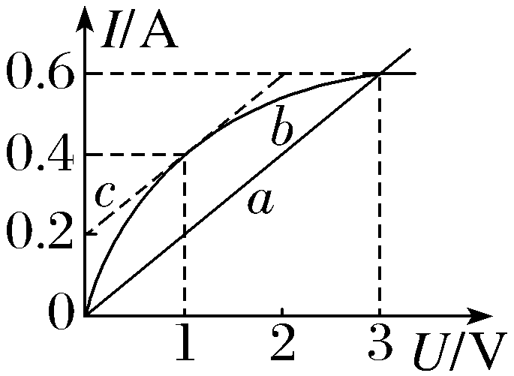
WORKED EXAMPLE 1
Resistance from a characteristic curve
Solid lines: the I–U characteristics of resistors a and b. Dashed line c is the tangent to b at U = 1 V, drawn parallel to a. Which statements are correct?
A
At U = 1 V, the resistance of b is 5 Ω
B
At U = 1 V, a and b have equal resistance
✓
C
The resistance of b rises as U rises
✓
D
At U = 3 V, a and b have equal resistance
ANSWER C · D Resistance is U/I at the point — never the slope of tangent c. For b it rises from 1 V/0.4 A = 2.5 Ω to 3 V/0.6 A = 5 Ω, matching a there — and a stays at 5 Ω throughout.
RESISTANCE OF A CONDUCTOR
14

Slide 15
WORKED EXAMPLE 2
Testing the factors fairly
In the series circuit from our experiment, b differs from a only in length, c only in cross-section, d only in material. Which statement is correct?
A
Without an ammeter, no quantitative study is possible
✓
B
a vs b: the longer conductor gives the larger voltmeter reading
C
a vs c: the thicker conductor gives the larger reading
D
a vs d: a larger reading means the better-conducting material
ANSWER B Same current everywhere, so U = IR ranks the resistances. Longer → larger R → larger reading (B). Thicker means smaller R (C ✗); a larger reading marks the worse conductor (D ✗); and the reading ratios already give the quantitative law (A ✗).
RESISTANCE OF A CONDUCTOR
15

Slide 16
WORKED EXAMPLE 3
Thinking straight about resistivity
Which statement about the resistivity of materials is correct?
A
Cut a wire into three equal lengths — each piece has a third of the resistivity
KEEP APART
ρ belongs to the material (and its temperature).
R belongs to the object: geometry included, via R = ρL/S.
B
Every material's resistivity rises with temperature
✓
C
An alloy's resistivity exceeds that of the pure metals composing it
D
The larger the resistivity, the more a conductor opposes current
ANSWER C Resistivity never depends on shape (A ✗). Semiconductors fall with temperature (B ✗). Opposition to current is R, which geometry also sets (D ✗). Alloys do exceed their constituent metals (C ✓).
RESISTANCE OF A CONDUCTOR
16

Slide 17
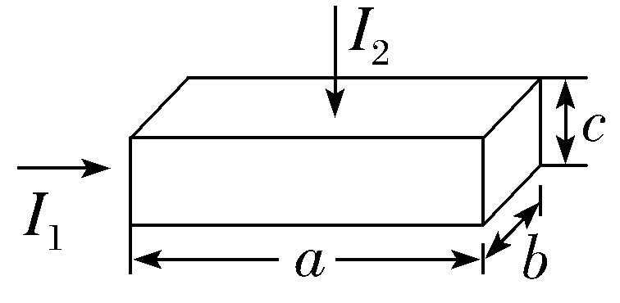
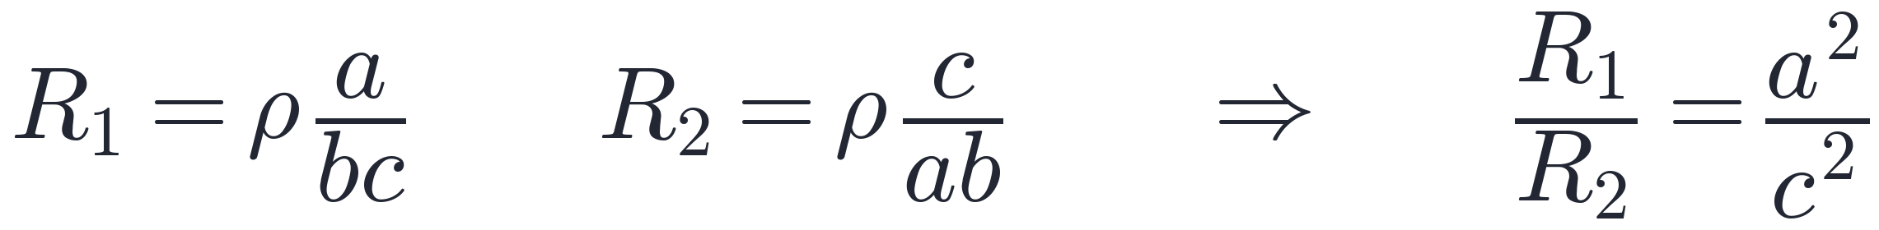
WORKED EXAMPLE 4
One block, two resistances
A copper block has edges a > b > c. Current can be sent lengthwise (along edge a, as shown by the left arrow) or down through the thickness (edge c, top arrow). Find the ratio of the two resistances, R1 : R2.
A
1 : 1
✓
B
a² : c²
C
a² : b²
D
b² : c²
ANSWER B Same material, same block — different geometry, different resistance.
RESISTANCE OF A CONDUCTOR
17

Slide 18
SUMMARY
What to take away
01
Definition
R = U/I — any conductor, any operating point. A ratio, never a tangent slope.
02
Ohm's law
I = U/R with R constant — a straight-line I–U graph. Metals and electrolytes only.
03
Resistance law
R = ρL/S — longer means more, thicker means less, material sets the scale.
04
Resistivity
A material property that moves with temperature: up for metals, down for thermistors, zero below the critical temperature of a superconductor.
RESISTANCE OF A CONDUCTOR
18

